Slide 1
Capstone Proposal
Amna Malik and Dylan Iden

Slide 2
Project Overview
Single-ball Breakout arcade game
Custom 3D-printed controller
VGA display (640 × 480)
Fully implemented in Verilog
Stretch Goal: Pong game mode

Slide 3
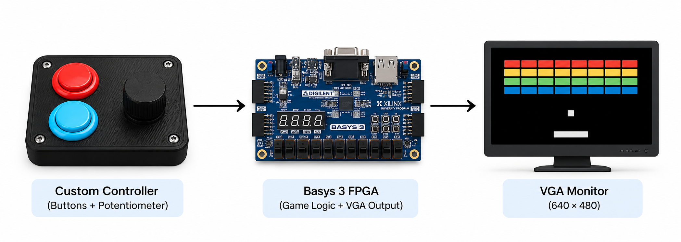
System Architecture
Potentiometer controls paddle movement
XADC converts analog voltage to digital data
FPGA processes game logic and collisions
VGA displays real-time gameplay

Slide 4
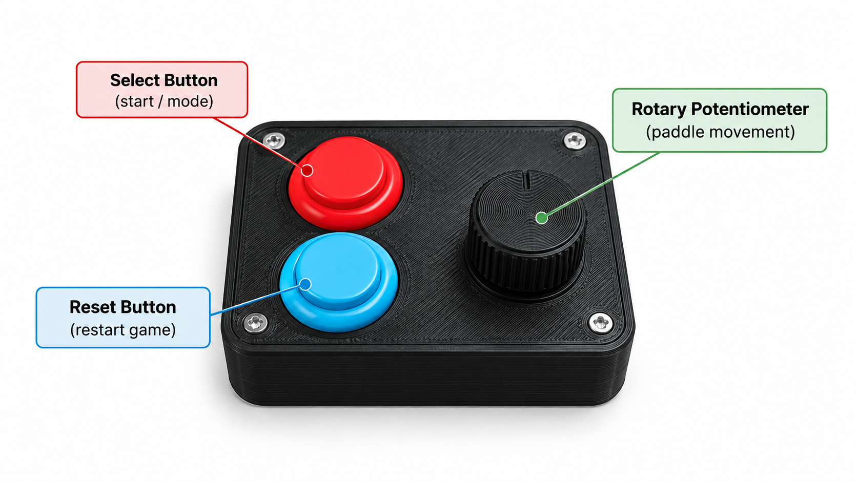
Custom Controller
Rotary potentiometer for paddle movement
Select button for starting gameplay
Reset button for restarting the game
3D-printed enclosure
Connected through FPGA I/O and XADC

Slide 5
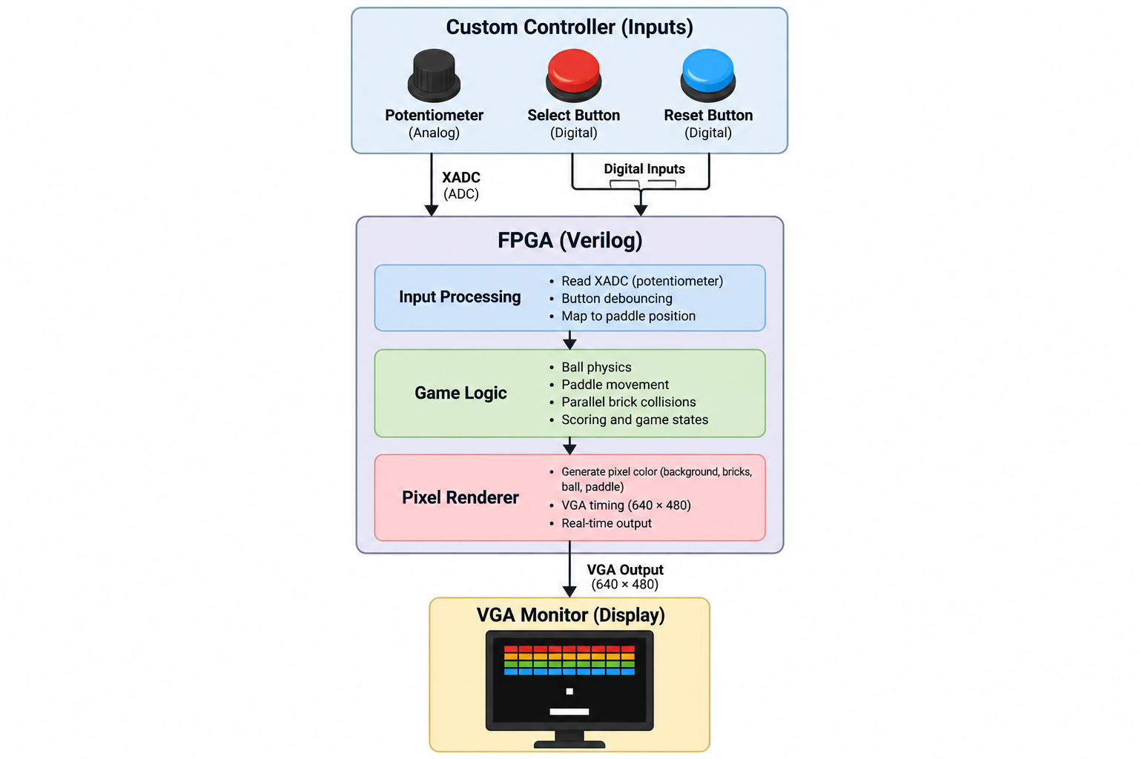
FPGA Processing
Input processing and button debouncing
Ball physics and paddle movement
Parallel brick collision detection
Scoring and game-state management
Real-time pixel rendering

Slide 6
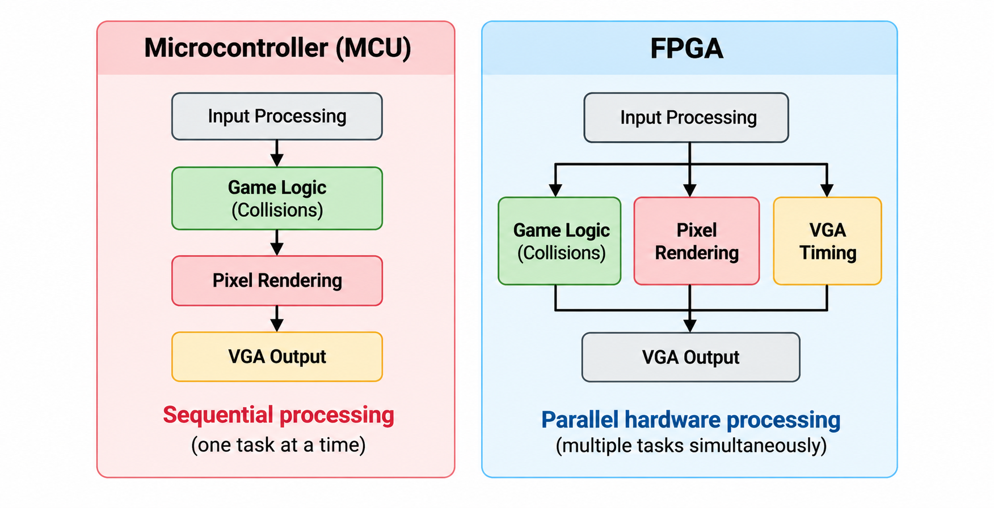
Why an FPGA?
Parallel collision detection
Independent hardware processing
Deterministic VGA timing
Scalable collision architecture
No external memory required

Slide 7
Technical Requirements
Two external devices: Controller + VGA monitor
Signal processing performed in Verilog
XADC for analog-to-digital conversion
On-chip memory and logic only
Vivado simulation and Python verification
Clock domain crossing, if implemented

Slide 8
Development Plan
Phase 1: Controller assembly and VGA output
Phase 2: Paddle movement and ball physics
Phase 3: Brick collisions, scoring, and game states
Phase 4: Verification and performance testing
Stretch Goal: Pong game mode

Slide 9
Questions?

